Slide 1
QA Project 2
Basketball Game Generator
Umayr Ahmed

Slide 2
before

Slide 3
The brief
The project needs to utilise the following technologies:
Kanban Board: Asana or an equivalent Kanban Board
Version Control: Git
CI Server: Jenkins
Configuration Management: Ansible
Cloud server: GCP virtual machines
Containerisation: Docker
Orchestration Tool: Docker Swarm
Reverse Proxy: NGINX

Slide 4
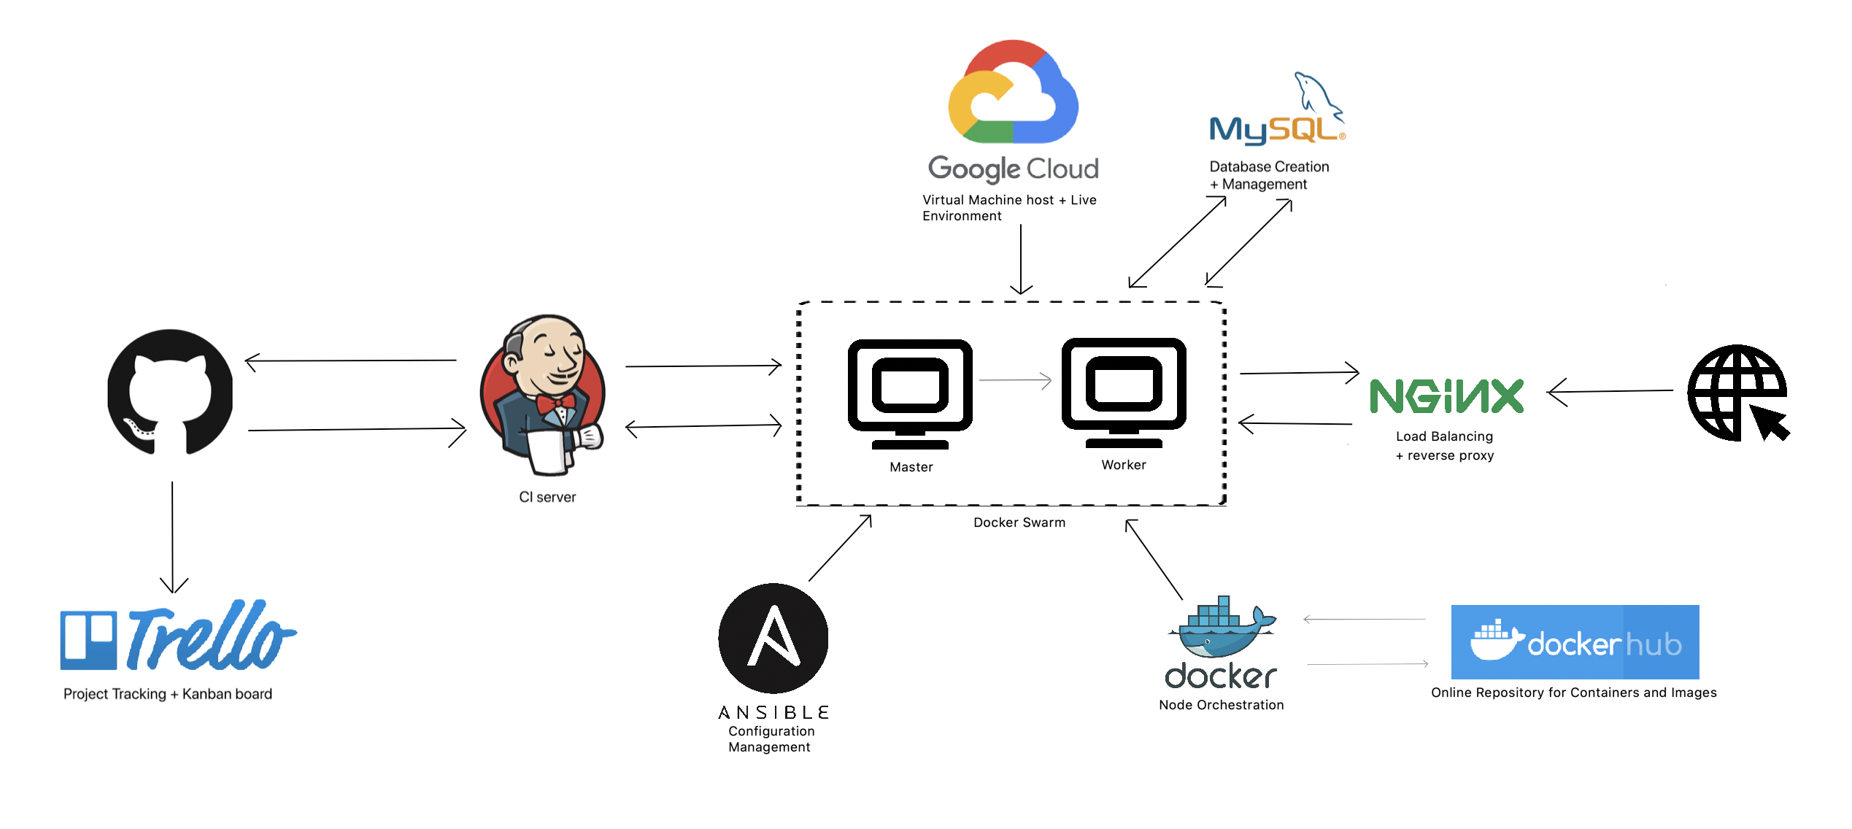
My solution
CI Pipeline

Slide 5
My Application
Service 2 – Select two random Basketball teams
Service 3 – Select a random Stadium
Service 4 – Depending on the outcome of Service 2 and Service 3, return the chance of one team winning

Slide 6
DURING

Slide 7
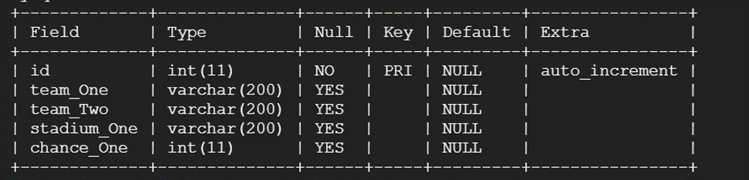
My solution
Design for SQL

Slide 8
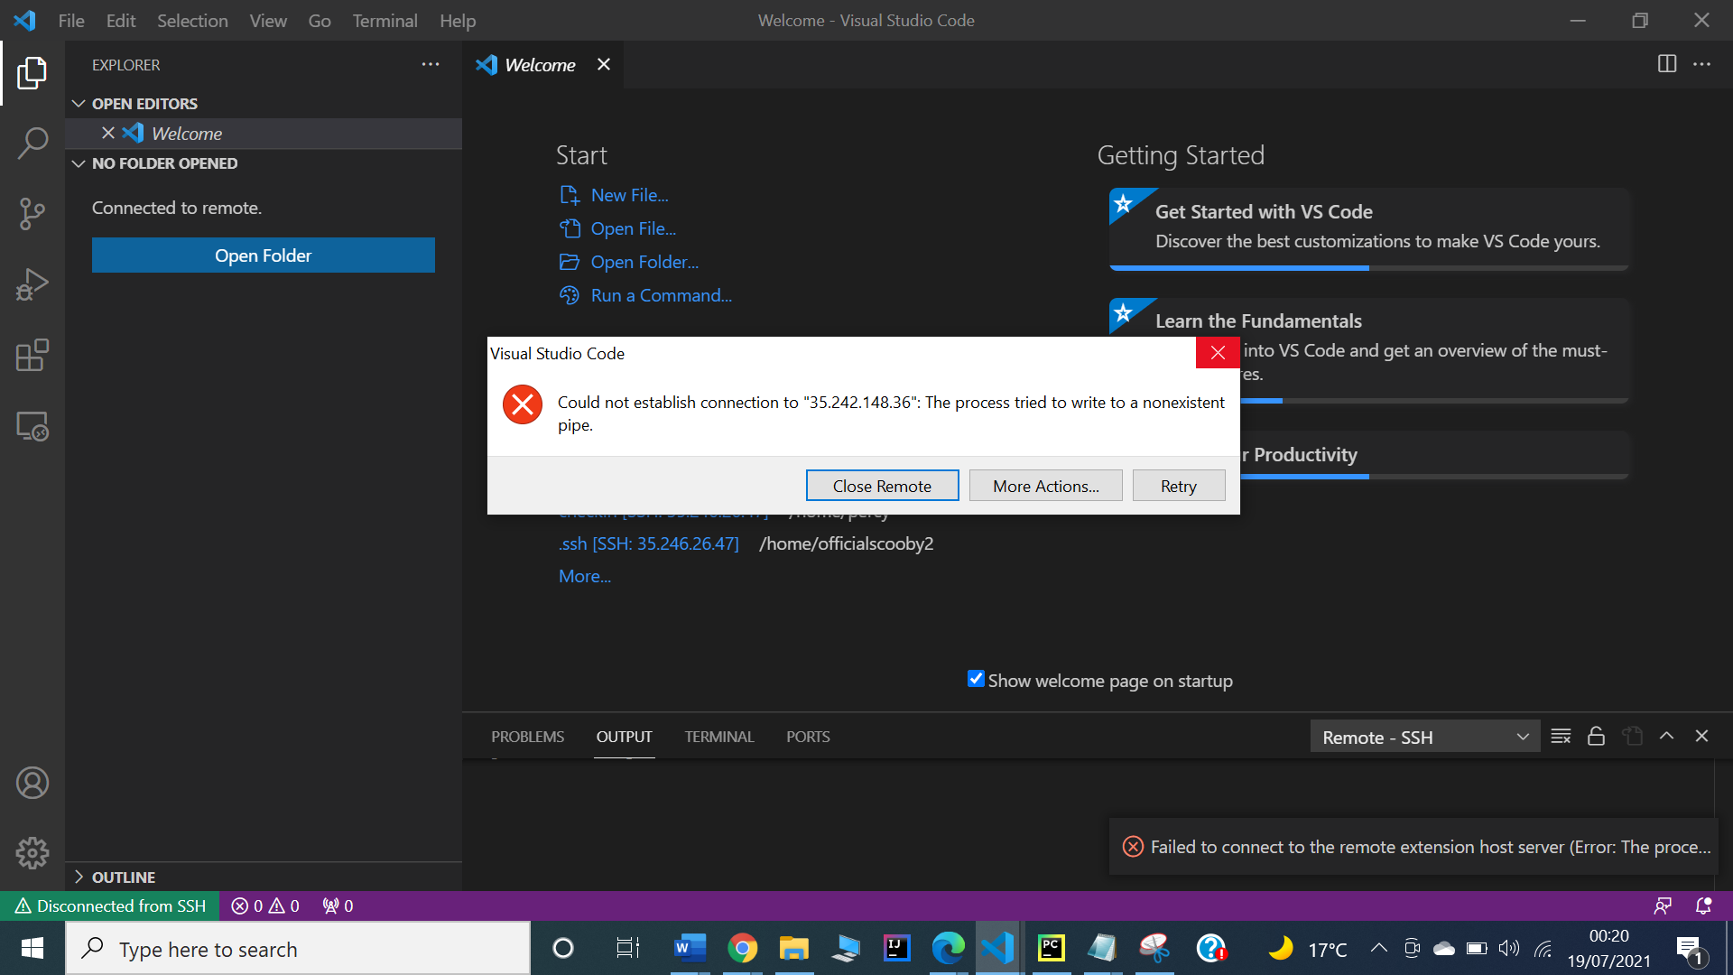
ISSUES

Slide 9
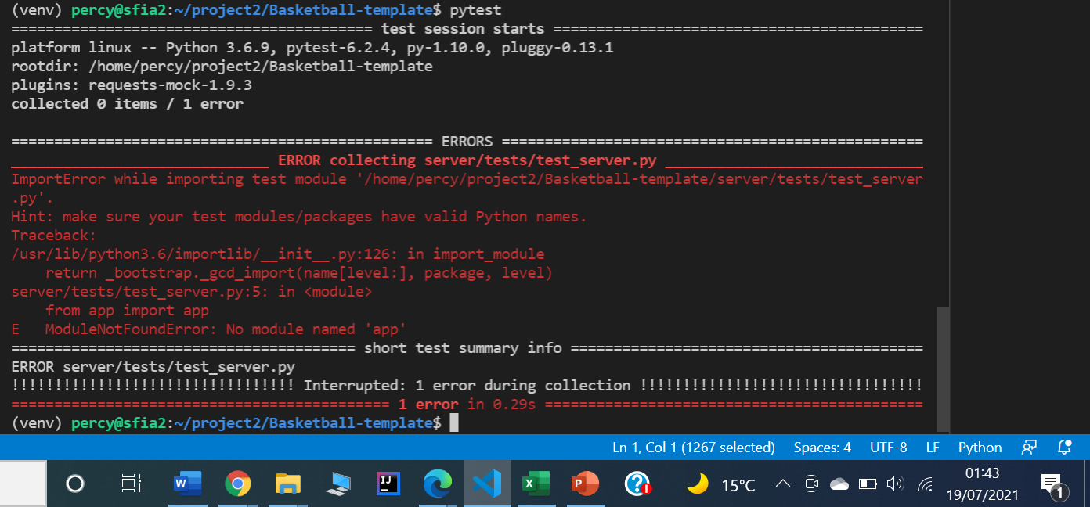
Testing ISSUES

Slide 10
After

Slide 11
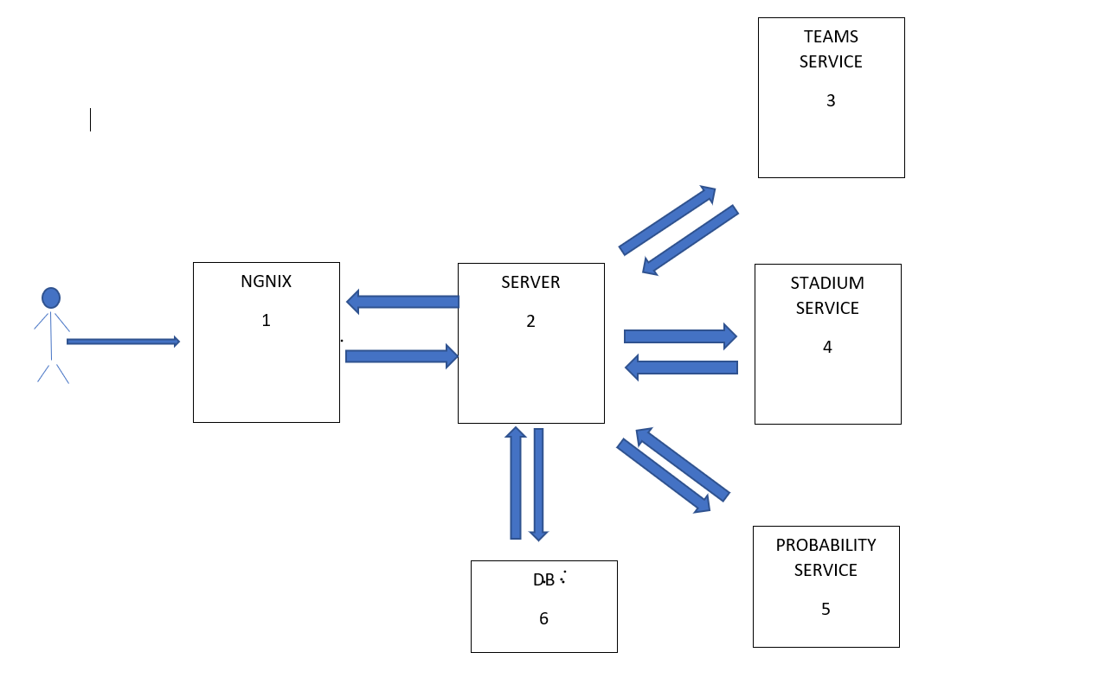
NGINX

Slide 12
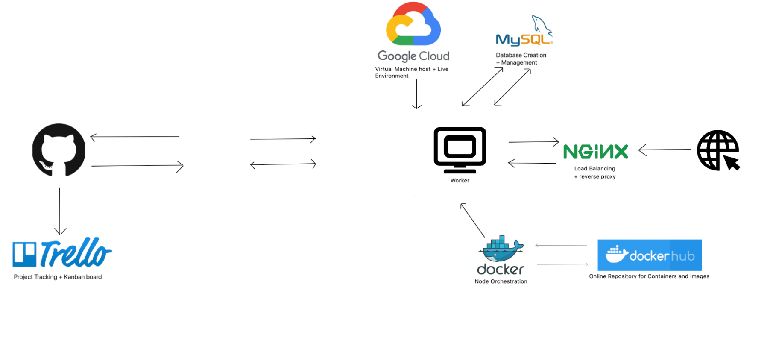


Slide 13
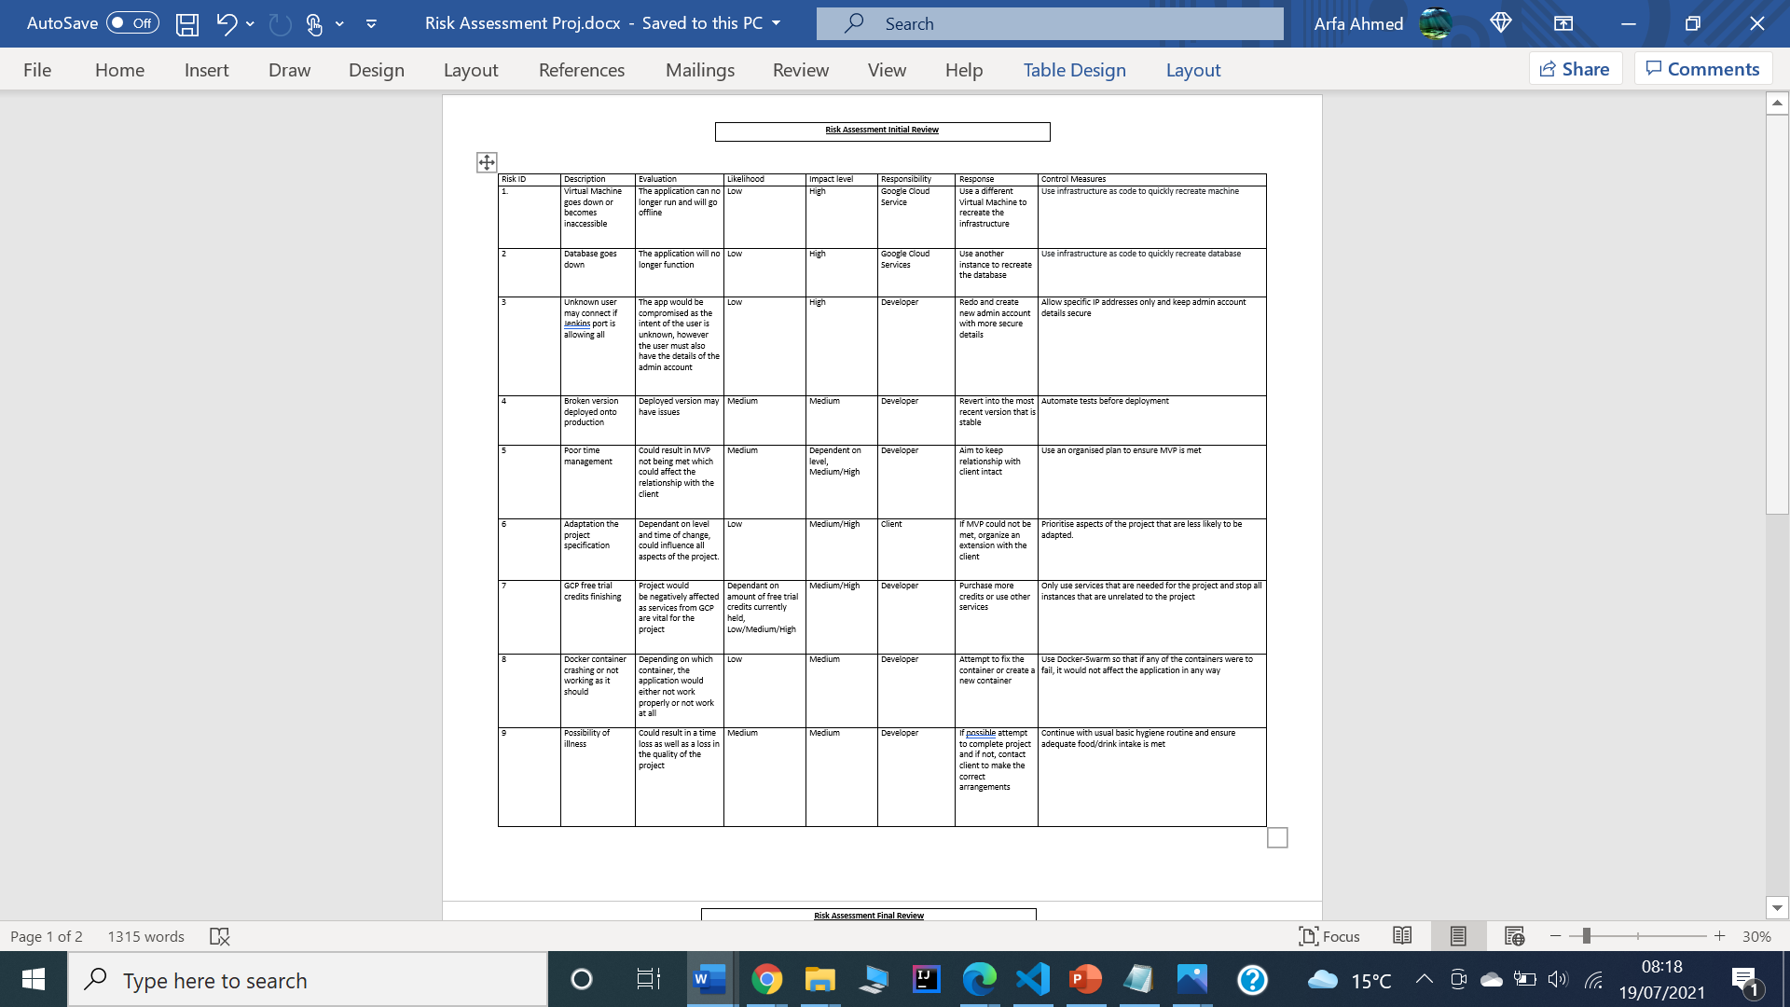
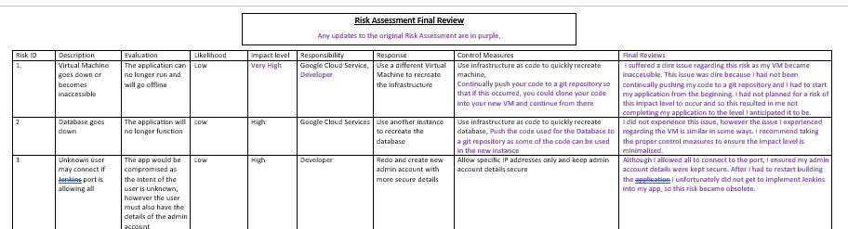
Additionals

Slide 14
Additionals
Full Risk Assessment can be found in my Github Repository
umayr12/SFIA2 (github.com)
Trello Board
PROJECT 2 BOARD | Trello
Dockerhub
00000000007860000000000's Profile | Docker Hub

Slide 15
Retrospective
What went well
Managed to create a working app with Docker despite issues
When creating the app for the second time, I managed to do it faster which shows that I learnt from the first time
Use of NGINX as a Reverse Proxy
Learnt the importance of continually committing to a VCS

Slide 16
Retrospective
What could have gone better and Improvements for the future
A full working app that integrates Docker-Swarm, Ansible and Jenkins
Continually committed to a VCS to avoid time consuming issues
Fixed any issues with pytest
Better Management of Time, taking into account any issues that could arise and the time it takes to rectify these issues

Slide 17
Demonstration
˃ Demonstration of finished project

Slide 18
Questions and Feedback
˃ Thank you for listening

